Slide 1





A CORPUS ANALYSIS OF PREPOSITIONAL COLLIGATIONS IN THE NIGERIAN LEGAL DISCOURSE
BY:
IBRAHIM BASHIR (PhD.)
English Language Institute, Jubail Industrial College, Saudi Arabia
ASSOC. PROF. DR. KAMARIAH YUNUS
Faculty of Languages and Communication, UniSZA, Malaysia
October 3, 2020

Slide 2
Outlines of Presentation
Background of the Study
Research Questions
Methodology
Findings and Discussion
Implications and Conclusion

Slide 3
Background of the Study
Legalese
Colligation
The Status of English in Nigeria

Slide 4
Cont.
The Status of English in Nigeria
English is recognised as a national lingua franca of Nigeria. It plays crucial roles there, due to the complex and complicated ethnolinguistic landscape of Nigeria, with people speaking about 400 different languages.
Thus, English was adopted as a medium of instruction at almost all levels of the Nigerian educational system, in bureaucracy, the main mass media, national politics, science and technology, corporal companies, two legislative chambers, and the judiciary.
The Nigerian courts from the high court to the supreme court, are invariably conducting their entire businesses in English. Even the lower courts (Sharia and customary) that allow the use of the local languages, their proceedings most be drafted later in English.

Slide 5
Cont.
Legal language (legalese) is said to be ‘analytic’ language relying profoundly on prepositions to convey meanings (Sastri, 1988). It is hallmarked by excessive use of complex prepositions, such as due to, as a result of, for the purpose of (Goźdź-Roszkowski & Pontrandolfo, 2015).
Recent development in corpus linguistics had placed emphasis on the language used in a particular discourse and functions of texts as linguistic units.

Slide 6
Prepositional Colligations (PREP. COLL.)
Most of English prepositions are multi-words units; they co-occur with other word classes and function as subordinators, adjectives, adverbs and infinitive markers (to).
These kinds of prepositions are called complex prepositions, compound prepositions, phrasemes, or prepositional colligations.

Slide 7
Cont.
Empirical studies using corpus approaches had shown that prepositions are essential linguistic features of legal phraseology due to their semantic and pragmatic functions (Bahtia, 1998; Awab, 1999; Lindstromberg, 2010; Blakesley & Hoogeveen, 2012; Biel, 2014; Biel, 2015; Yunus, Awab, & Rashid, 2016).
Despite that, there is no study exclusively investigate the use of prepositional colligations in Nigerian legal discourse. Therefore, we hypothesised that since, English is used in both written and spoken language contexts in Nigeria, the colligations of prepositions should made essential phraseological profile.

Slide 8
Overarching Purpose of the Study
The present study purports to investigate the representativeness and essentiality of prepositional colligations in Nigerian legal texts.
Research Questions
Which prepositional colligations are commonly used in the Nigerian legal texts?
Are prepositional colligations essential phraseological profile of the Nigerian legal discourse?

Slide 9
Methodology
Corpus Approach
Our corpus (newly compiled) namely Nigerian Law Corpus (NLC) (546313 word-tokens).
Table 1: Compilation of NLC

Slide 10
Cont.
Two reference corpora:
British National Corpus of Law (BNCL – 2.2 million word-tokens)
British National Corpus of General Written English (BNCW - 1 million word-tokens) (explored using Lextutor, V.8.3)
We generated a list of 169 PREP. COLL. based on the lists obtained from previous studies such as: Quirk and Greenbaum (1976), Hawkins (1993), Parrot (2004), Murthy, (2007), Lindstromberg (2010), (Biel 2015), Yunus, Awab, and Rashid (2016), Yusuf (2017).
We displayed the frequency list of PREP. COLL. syntactic structures (phrase Structures), and the number of the instances of PREP. COLLI in three legal corpora (NLC, BNCL, and BNCW).
We normalised The frequency of each PREP. COLL. to 1,000,000 words.

Slide 11
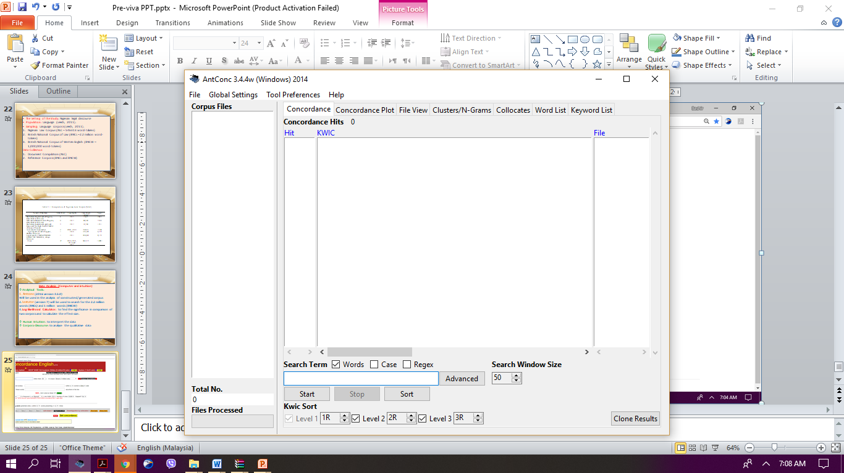
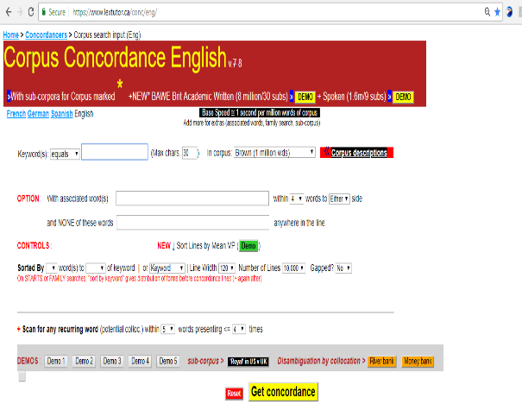
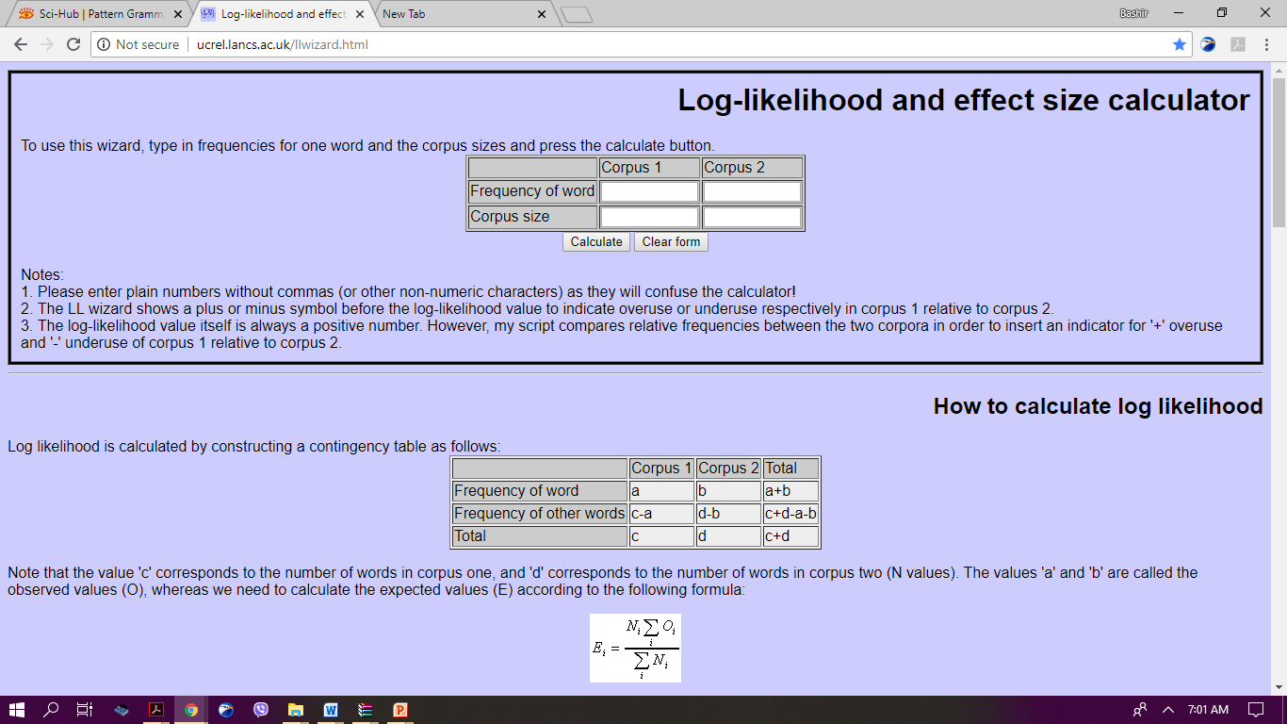
Cont.
We used Log-likelihood, observed frequency and relative frequency to compare the corpora and check the representativeness of PREP. COLL.
Analytical Tools:
AntConc (3.5.0) was used in the present study to analyse our main corpus (NLC).
Lextutor, corpus concordance English version 7 is a web-based corpus bank that can be searched online using http://www.lextutor.ca/conc/eng/.
Paul Rayson’s Effect-Size Calculator (Log-Likelihood Test).

Slide 12
Findings
RQ1: Which prepositional colligations are commonly used in the Nigerian legal texts?
We present the list and frequency distributions of the selected 169 prepositional colligations across the three corpora used in this study.
Table 2: Kinds of PREP. COLL.
Kinds of PREP. COLLI. Found in Each Corpus (Out of 169)
NLC | BNCL | BNCW
125 | 165 | 121

Slide 13
Table 3: Frequency List and Distribution of PREP. COLL. Based on NLC (Normalised to 1, 000,000 Words)

Slide 14
Below are the 125 PREP. COLL. That are found in NLC (Out of 169)
out of, up to, of course, according to, because of, due to, as to, in order to, sort of, close to, kind of, at the end of, away from, together with, apart from, in terms of, instead of, in the case of, as a result of, as far as, as for, ahead of, along with, subject to, in respect of, in addition to, at the time of, prior to, in spite of, but for, in favour of, far from, in the form of, on behalf of, next to, in accordance with, on the basis of, in relation to, in (the) absence of, in the context of, by means of, except for, in conjunction with, in the event of, for the benefit of, in line with, in the light of, in view of, contrary to, owing to, in charge of, with regard to, with regard to , in support of, at the expense of, in between, in the course of, on the part of, in the face of, in the process of , with the exception of, by way of, regardless of, in return for, with a view to, irrespective of, in place of, up against, for the purpose of, in response to, as of, in due course, for the sake of, for the use of, in need of, by virtue of, in connection with, with respect to, in the presence of, of the order of, adjacent to, by reference to, as regards, by (the/an) order of, in common with, by order of, outside of, in reaction to, from the date of, for fear of, within the framework of, of (the) court of, on account of, in regard to, with reference to, to the right of, pertaining to, in settlement of, by recourse to, without fear of, pursuant to, within the meaning of, by reason of, in consequence of, in reliance on, in ignorance of, in conformity with, for consideration of, in comparison with, as a matter of fact, upon receipt of, aside from, under threat of, in deference to, in company with, in sympathy with, by force of, in respect to, in concert with, in league with, in readiness for

Slide 15
Below are the 44 PREP. COLL. That are not found in NLC (Out of 169)
in pursuance of, in consideration of, without prejudice to, in compliance with, in restraint of, in contravention of, in default of, by operation of, on pain of, out of court, subsequent to, on the/a matter of, in exercise of, for (the) possession of, in point of, by analogy with, in fear of, in contemplation of, with the approval of, in violation of, on the occasion of, within the territory of, on proof of, by word of, with approval by, by act of , under mistake of, by courtesy of, in furtherance of, in fairness to, from lack of, in proof of, as par, in reference to, in furtherance o, without the approval of, from loss of, by appeal to, in a court of, with due respect, in contradistinction to, in obedience to, on production of, in liaison with, for completion of, for the review of, in a ground of, in contradiction to.

Slide 16
RQ2: Are prepositional colligations essential phraseological profile of the Nigerian legal discourse?
Table 4: Frequency Distributions of PREP. COLL. in the 3 Corpora

Slide 17
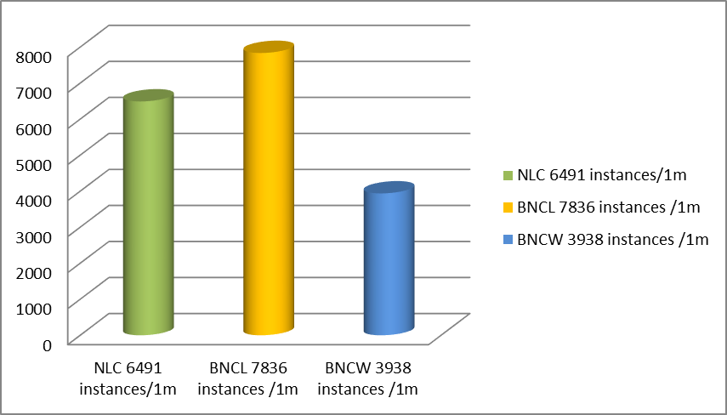
Figure 1: The Frequency Distributions of PREP. COLL. across NLC, BNCL and BNCW

Slide 18
Over-representation, Under-representation of PREP. COLL. in the Nigerian Legal Texts
Any PREP. COLL. with LL critical value greater than 3.84 is significant at 5 % level (+/- P <0.05), while any prepositional colligation with LL critical value greater than 6.63 is significant at 1 % level (+/- P <0.01).
Any PREP. COLL. with LL critical value less than 3.84 is not significance. This means, difference between the two comparative corpora will have no effect, if the difference is not significant.
Table 5: Prepositional Colligations Observed Frequency, Relative Frequency, Sign Effect, and Log-likelihood Counts (based on NLC - BNCL)
PREP. COLLI. NLC – BNCL (p < 0.05; LL critical value = 3.84; p < 0.01; LL critical
value 6.63)
The findings show that PREP. COLL. are relatively under-represented in the NLC compared with BNCL (0.66 and 0.81) with a LL value of (-/134.82) which is insignificant at 1% level; p < 0.01.

Slide 19
Table 6: Prepositional Colligations Observed Frequency, Relative Frequency, Sign Effect, and Log-likelihood Counts (based on NLC - BNCW)
PREP. COLLI NLC – BNCW (p < 0.05; LL critical value = 3.84; p < 0.01; LL critical value 6.63)
The findings reveal that prepositional colligations were relatively more frequent in the Nigerian legal discourse (0.66 compared 0.81) with a LL value of (+500.43) which is significant at 1% level; p < 0.01. This means that prepositional colligations were found to be the distinctive linguistics features of Nigerian legal discourse.

Slide 20
Table 8: Prepositional Colligations Observed Frequency, Relative Frequency, Sign Effect, and Log-likelihood Counts (based on NLC - BNCL)

Slide 21
Table 9: Prepositional Colligations Observed Frequency, Relative Frequency, Sign Effect, and Log-likelihood Counts (based on NLC - BNCW)

Slide 22
Implications and Conclusion
The study concludes that prepositional colligations were important linguistic elements that formed the phraseological profiles of the Nigerian legal discourse due to their prevalent distributions.
Therefore, the study implies that:
PREP. COLL. should be given special attention in designing legal language curriculum in tertiary institute.
This study disseminate information about representativeness and essentiality of prepositional colligations in legal language and legal discourses. This will help to better understand the nature of the Nigerian legal texts.
Particularly, the study will help Lawyers/legal language drafters and other law practitioners by providing them with this syntantagmatic nature of legalese.

Slide 23
Contact:
Bashiribrahimkn@gmail.com
Twitter: @bashelkalil

Slide 24
